Slide 1
Using shiny apps for communication and engagement of your research
George Linney

Slide 2
Structure of this workshop
Up to 30 minutes of me talking
What
Why
How
30 minutes of playing with some demo apps

Slide 3
What is a shiny app

Slide 4
Why should you make Shiny apps
To support your papers
Comunicating large amount of information
Support for 3D visualisations
Allows a user to complete analysis themselves
Context
Notes:
Context: Allow for user to explore what they want to explore https://shiny-apps.ceh.ac.uk/LiNCAGES/.
Supporting your paper
Show more information https://glinney.shinyapps.io/NCA_interlinkages_and_ES/
Science is complex – there’s always more to say than a paper allows
- Many figures that you do not get the show in a paper
End up in supplementary but is a large word doc the most engaging way of displaying them?
Allow user to complete the analysis themselves https://glinney.shinyapps.io/NCA_interlinkages_and_ES/

Slide 5
Why should you make Shiny apps
To support researchers and decision makers
Context dependency
Preference
Notes:
This is why I started making shiny apps at the start of my PhD
Context:
Preference allow for user to explore what they want to explore https://shiny-apps.ceh.ac.uk/LiNCAGES/.

Slide 6
Why should you make Shiny apps
Data collection
Collect new data (limited to certain types of data)
Collect data on how a user interacts with the app
Collect citizen science data
Notes:
Engagement and outreach:
CEH butterfly app
This increased engagement will make it easier to communicate your work to non scientific audiences
And makes your work stand out when compared to non interactive forms of communication

Slide 7
Why should you make Shiny apps
Engagement and outreach
Interaction with the app engages people
Support for citizen science
Makes your work stand out
Notes:
Engagement and outreach:
CEH butterfly app
This increased engagement will make it easier to communicate your work to non scientific audiences
And makes your work stand out when compared to non interactive forms of communication

Slide 8
Things to be careful of
Misleading
Overinterpretations
Notes:
The user has more control due to the interactive nature of the figure
Which opens your app up to over interpretation and it could be potentially misleading
Example – you have an app where user can zoom in on map they may zoom into a resolution that is not appropriate.

Slide 9
How to create a shiny app
Are Shiny Apps hard to create?
Notes:
Are Shiny Apps hard to create?
Shiny apps are designed to be very easy to get up and running quickly
Simple apps a very easy to create
But this ease is also their limitation when it gets to making more complex shiny apps
For example shiny apps are reactive – which means that everything in the server is by default watching every user input
There are times when you don’t want this – such as when your app completes more computationally intensive activities
There are packages to manage this complexity but we don’t have time to cover these in this talk

Slide 10
How to create a shiny app
First check that you need to create one
Notes:
Shiny apps add complexity – is there a good reason for creating
Best way to learn is through looking at how an existing app works

Slide 11
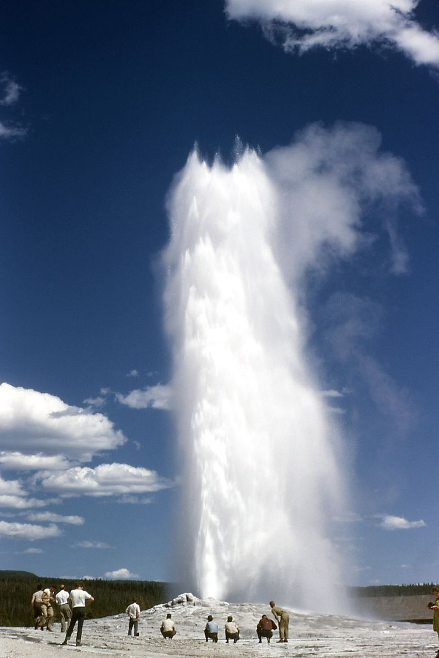
Old faithful Geyser
A simple Shiny app that displays eruption data for the Old Faithful geyser.
https://shiny.rstudio.com/gallery/faithful.html

Slide 12
Old faithful geyser app
Exploring the app further
Download the underlying code from https://github.com/glinney/faithful
Click green code button and then download as zip
Extract folder and copy to a more appropriate place
Run from the R studio console with runApp(“~/faithful-main”)
Now you can add elements to the code
For example I added the ability to choose the colour of the bars of the histogram - uncomment the code to try it out

Slide 13
Valuing land in Belgium
Pre-processing:
Raster of the CORINE2018 land cover map classified to its broad level 2 land classifications cropped to Belgium where the values:
1 = Artificial surfaces
2 = Agricultural areas
3 = Forest and semi natural areas
4 = Wetlands
5 = Water bodies
https://github.com/glinney/A4Cap2023shinyapp - for code
Data labs link - for app

Slide 14
Additional apps to explore
https://shiny.rstudio.com/gallery/#user-showcase

Slide 15
Further information
If you prefer to code in Python, Shiny is now available for Python (currently in alpha https://shiny.rstudio.com/py/)

Slide 16
To do
Check that we have install packages commented out in all of the demo scripts
Check if I can download and run the app using r studio ui in server file (faithful app)
Send out another email containing the materials
Terra basemap

